Slide 1
DATA SCIENCE
10 WEEK PART TIME COURSE
Week 3 - Regression

Slide 2
AGENDA
Motivation
Supervised Vs Unsupervised learning
What is Linear Regression?
Interactive immersive experience
How to run a Linear Regression Model
Which linear regressors should you use?
Lab
Discussion / Review / Homework

Slide 3
WHAT ARE THE GOALS OF STATISTICAL LEARNING?
DATA SCIENCE PART TIME COURSE

Slide 4
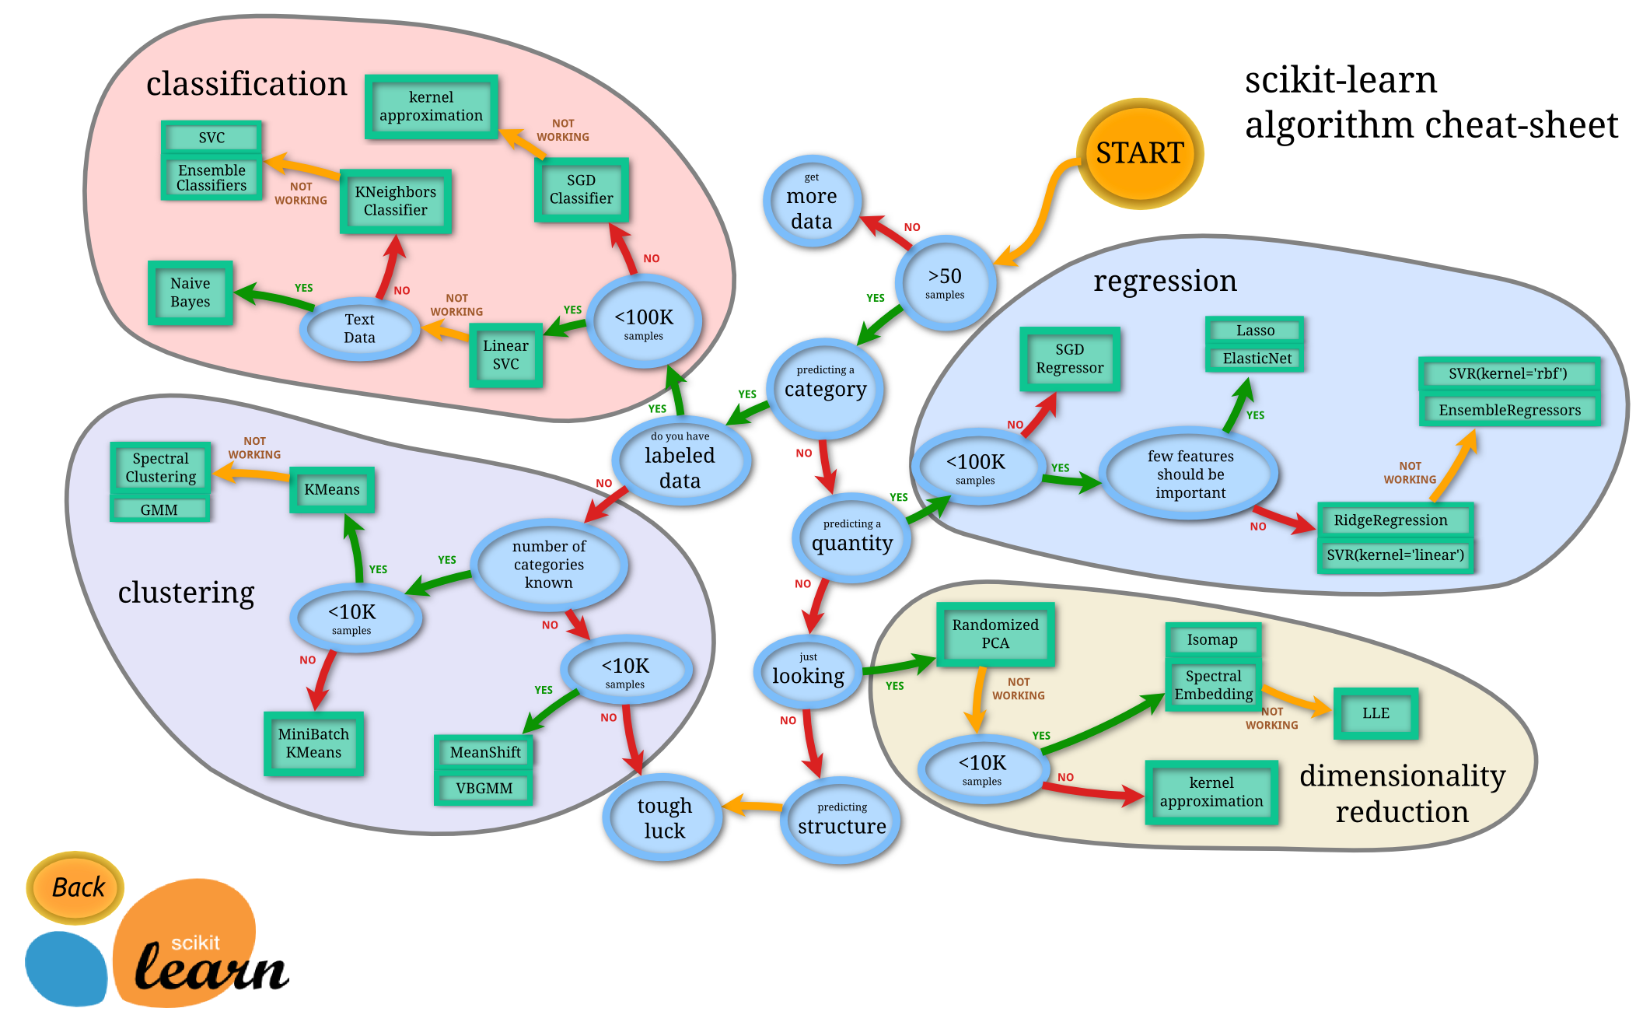

Slide 5
UNSUPERVISED LEARNING
We want to find some underlying structure or patterns in the data but in this case we don’t have any labeled data.
So for example, if we have a large group of customers but would like to separate them into groups (or clusters) to better target them.
We’ll cover this later

Slide 6
SUPERVISED LEARNING
We want to predict some value, let’s call it y, based on some observed data we have, let’s call that x.
We will use statistical learning to estimate a function that approximates y based on the input, x.
y is also called; label, dependent variable, target
x is also called; predictor, independent variable, features

Slide 7
SUPERVISED LEARNING - EXAMPLE
We want to predict the price of a house, let’s call it y, based on some observed data we have about the area, number of bedrooms, size of the house, and if it has a pool or not.
The area, number of bedrooms, size of the house, and if it has a pool or not would be our x variables (sometimes you might see this denoted as X)
What we want is y = f(X), a way to describe the house price based on observed data

Slide 8
SUPERVISED LEARNING - REGRESSION & CLASSIFICATION
If the y variable is numeric then we have a regression problem - we are trying to predict a continuous number
If the y variable is a category (for example trying to predict a type of flower) the we have a classification problem - we are trying to classify what group that y belongs to.
We want We have | A number | A category
Numbers | Linear regression | Logistic regression; decision tree; svm
Categories | Mean differences | Bayes

Slide 9
WHAT IS LINEAR REGRESSION?
DATA SCIENCE PART TIME COURSE

Slide 10
LINEAR REGRESSION
We want to model a linear relationship (think straight line) between our target variable y and our input variable x.
y=Xβ+ϵ

Slide 11
LINEAR REGRESSION
y=Xβ+ϵ
y = target variable
X = input variable
β = coefficients
ϵ = error term
Note, one of our input variables can be 1 so we have an intercept parameter

Slide 12
FLAKEY UNRELIABLE REGRESSION
DATA SCIENCE PART TIME COURSE

Slide 13
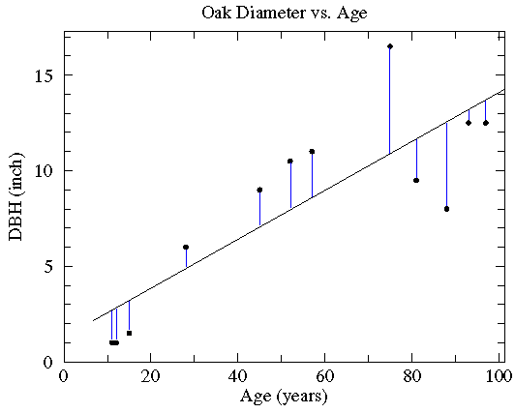
ORDINARY LEAST SQUARES

Slide 14
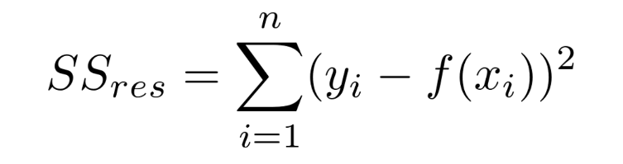
ORDINARY LEAST SQUARES
y=Xβ+ϵ
Basically, what we are trying to do is minimise the Residual Sum of Squares. This is the Sum of the squared difference between our observed value and the value from the model

Slide 15
ORDINARY LEAST SQUARES
y=Xβ+ϵ
Basically, what we are trying to do is minimise the Residual Sum of Squares. This is the Sum of the squared difference between our observed value and the value from the model

Slide 16
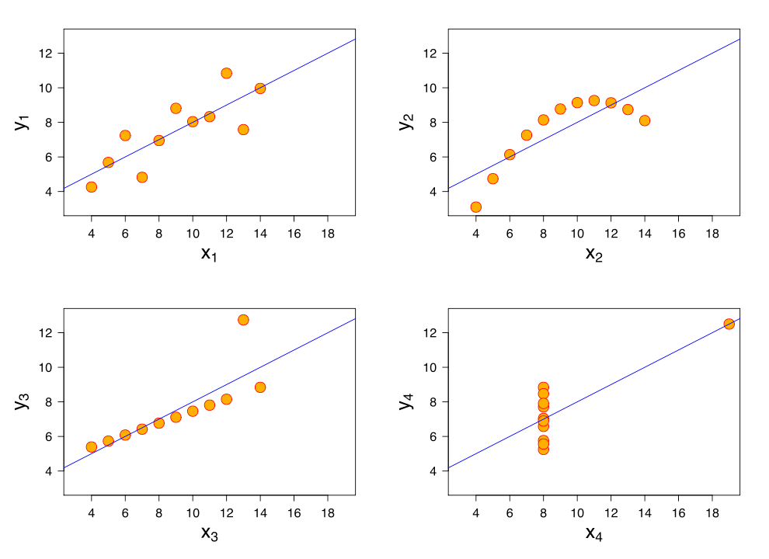
LINEAR REGRESSION – WHY IT’S FLAKEY

Slide 17
LINEAR REGRESSION - REQUIREMENTS
Linear relationship in the parameters, β, we can transform the actual values of the inputs if we want
Variance of the error term, ϵ, is constant. This means there is no systematic pattern in the values of X and the variance of ϵ
The mean of ϵ = 0
ϵ has a normal distribution
No perfect (or near perfect) co-linearity between any of the input variables. Otherwise the fitting procedure will break.

Slide 18
ROBUST LINEAR REGRESSION
DATA SCIENCE PART TIME COURSE

Slide 19
THEIL-SEN
Randomly pick pairs of points
Draw lines between these pairs
Choose the middle line – the one with the median gradient
Copes very well with outliers in the X-direction, and moderately well with Y
Even if nearly 30% are outliers
Can be generalized to higher dimensions, but isn’t very good

Slide 20
RANSAC
Pick a random pair of points
Draw a line through them with thick texta
Count the number of points the texta touched
Repeat the first 3 steps until you find something good enough
Copes well with Y-axis outliers
Even 50% outliers
Generalises well to higher dimensions
Pick a random triple of points and draw a plane..

Slide 21
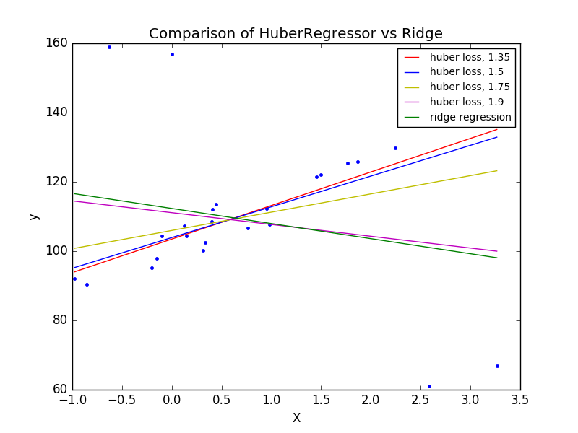
Huber
Identifies outliers
Penalises them with a linear penalty instead of a squared penalty
Works pretty well out-of-the-box with no special parameters
Added to scikit-learn in version 0.18
Faster than TheilSen and RANSAC
Unless you want a quick answer from a large low-dimensional dataset

Slide 22
INTERACTIVE IMMERSIVE EXPERIENCE
DATA SCIENCE PART TIME COURSE

Slide 23
Let’s wander out to the break room
36 point markers
String
Dice
Scissors
Post-it notes

Slide 24
Advice
Visualisation / Identification
Graph with your dataframe with pandas.scatter_matrix()
Dataframes have a .corr() method
Algorithm Choice
If you have a lot of dimensions, use Huber
If you have a lot of data (millions of rows, a few columns), use RANSAC
If RANSAC doesn’t work well, try tweaking some parameters
If RANSAC still doesn’t work well, try Theil-Sen.
If Huber, Theil-Sen and RANSAC don’t work, are you sure there’s a linear relationship there?
If you are totally desperate, try every other linear regression, including Ordinary Least Squares

Slide 25
SCIKIT-LEARN
DATA SCIENCE PART TIME COURSE

Slide 26

Why Scikit-Learn?
Widest library of data science / machine learning algorithms
Very efficient
Easy-to-use from Python
Can work with pandas DataFrames

Slide 27
Scikit-learn versus Spark MLLIB
 | Scikit-learn | Spark MLLIB
Best for | Small-to-moderate datasets | Massive datasets
Processing model | Single computer | Hadoop Cluster
Speed | Very fast | Slower
Language bindings | Python only | Python, Java, Scala

Slide 28
Installing Scikit-Learn
sklearn is already installed with jupyter / anaconda.
Otherwise (on a command-line): pip install sklearn
How to check
import sklearn.linear_model

Slide 29
Linear Regressors
Classes for each algorithm:
sklearn.linear_model.LinearRegression()
sklearn.linear_model.TheilSenRegressor()
sklearn.linear_model.RANSACRegressor()
sklearn.linear_model.HuberRegressor()
Call the .fit() method with:
Arg 1 (X) = a multi-column dataframe of what you have
Arg 2 (y) = a Series or single-column dataframe of what you want to predict (the dependent variable)
Useful functions / attributes:
predict()
coef_ and intercept_ (LinearRegression, Huber and TheilSen)
estimator (RANSACRegressor only: is a LinearRegressor)

Slide 30
DataFrame mangling reminder
df[ ["BEGINNING_COLUMN": "ENDING_COLUMN"] ]
Column selection list [A:B]

Slide 31
Putting it all together – 1 dimensional linear model
import sklearn.linear_model
import pandas
import matplotlib.pyplot
Dataframe = pandas.read_csv('somefilename.csv')
Regressor = sklearn.linear_model.TheilSenRegressor()
X = Dataframe[['column_name_x':'column_name_x']]
y = Dataframe.column_name_y
Regressor.fit(X,y)
Predictions = Regressor.predict(X)
matplotlib.pyplot.scatter(Dataframe.column_name_x, y)
matplotlib.pyplot.plot(Dataframe.column_name_x, Predictions,
color='blue')

Slide 32
Apologies and Disclaimer (Do not try this at work)
In the previous slide, we trained our regressor on the data in a dataframe
Then we predicted the results using the same data
This tells us the best result we could ever hope to get
It’s not a very good way of knowing what we typically will get
In practice it almost definitely won’t work
Because otherwise we could create a “memory regressor” that just reproduced exactly the numbers it was trained on
But Theil-Sen only randomly samples, so it’s not super silly.
And RANSAC randomly samples as well, so it’s not too silly there either

Slide 33
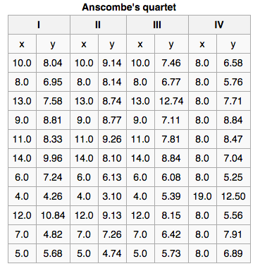
DATA DEMONSTRATION – ANSCOMBE’S QUARTET
Make sure you visualise your data and check the actual model fit !!!
The fitting a model to the four datasets in the table on the right produce the same fit statistics, model coefficients and standard error
See anything wrong?

Slide 34
LINEAR LAB
DATA SCIENCE PART TIME COURSE

Slide 35
WHAT DO WE DO IF THE DATA ISN’T LINEAR?
DATA SCIENCE PART TIME COURSE

Slide 36
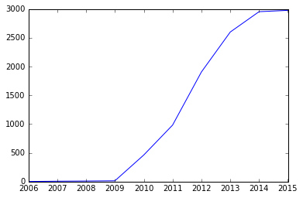
HOCKEY STICK DATA – TWO OR MORE LINEAR SEGMENTS
Cluster the data, then analyse each cluster
Study the inflection point – it might be interesting!
Romanian installed wind power
Capacity 2006-2015 (Wikipedia)

Slide 37
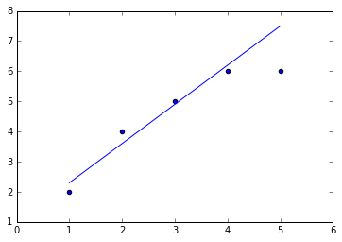
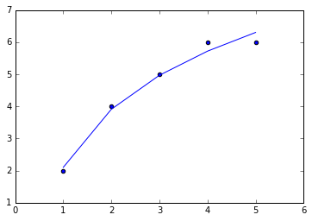
SATURATION: THE EFFECT GETS WEAKER
Try regressing against the log of X
import math
new_column = dataframe.columnX.map(math.log)

Slide 38
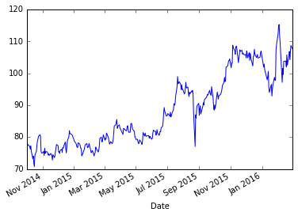
FACEBOOK (NETWORK) EFFECT
Network value doesn’t usually grow exponentially
If x is the total number of users:
Each user gets value at log(x)
Total value is x * log(x)
Create a “user value” column
Create a “total value” column
Regress against “total value”
Facebook share price Nov 2014-March 2016
Above linear growth

Slide 39
NON-LINEARITY LAB
DATA SCIENCE PART TIME COURSE

Slide 40
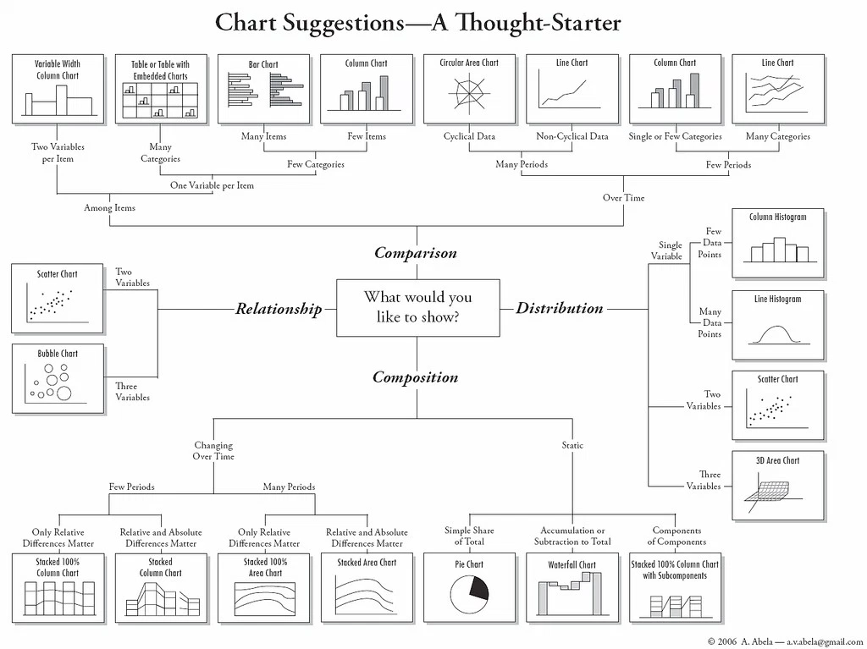

Slide 41
DISCUSSION TIME
Homework/Course Project
How’s it going ?
DATA SCIENCE - Week 3 Day 1

